Slide 1
UNIVERSITY INSTITUTE OF ENGINEERING
Department of Computer Science & Engineering
Databases Management System
(23CSH-205/23ITH-205)
DR. GITANJALI
E16525
ASSISTANT PROFESSOR
CSE
DISCOVER . LEARN . EMPOWER

Slide 2
ABOUT COURSE
The main DBMS course, we learn about the structural formation of data, maintain data integrity, multitasking with concurrent access and recovery without occurring crashes, data structures, data models etc. and their working in which every organization is based.
At the end of the course, the students may understand the concepts of data structures, data models and design, construction of queries by using SQL, uses and applications of database design etc

Slide 3
COURSE OUTCOMES
CO No. | Title | BT Level
CO1 | Students will be able to understand the database system concepts and design databases for different applications. | Memorize
CO2 | Students will be able to identify different types of DDL, DML, DCL and TCL commands and their usage. | Understanding
CO3 | Students will be able to classifying Normalization, Dependencies and Denormalization along with their requirements. | Apply
CO4 | Students will be able to analyse and Compare Transaction Processing techniques and Recovery techniques. | Analyze
CO5 | Students will be able to evaluate database performance after implementing Triggers, procedures, packages, cursors and views. | Evaluate
Will be covered in this lecture

Slide 4
COURSE OBJECTIVES
This course will enable students to,
To have good understanding of database system concepts and design databases for different applications.
To learn how to use a DBMS and RDBMS.
To implement and understand different types of DDL, DML and DCL statements.
To understand transaction concepts related to databases and recovery/backup techniques required for the proper storage of data.

Slide 5
Topics covered
Transaction Management and Concurrency Control:
Introduction to Transaction Processing, Properties of Transactions, Serializability and Recoverability, Need for Concurrency Control, Locking Techniques, Time Stamping Methods, Optimistic Techniques and Granularity of Data items.

Slide 6

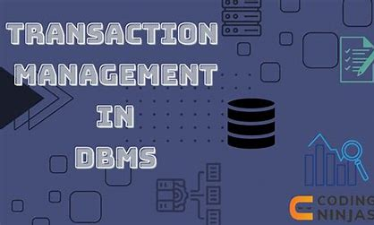
Transaction Management
Transactions are a set of operations used to perform a logical set of work. A transaction usually means that the data in the database has changed. One of the major uses of DBMS is to protect the user data from system failures. It is done by ensuring that all the data is restored to a consistent state when the computer is restarted after a crash. The transaction is any one execution of the user program in a DBMS. One of the important properties of the transaction is that it contains a finite number of steps. Executing the same program multiple times will generate multiple transactions.

Slide 7

Transaction Management
Example: Consider the following example of transaction operations to be performed to withdraw cash from an ATM vestibule.
Steps for ATM Transaction
Transaction Start.
Insert your ATM card.
Select a language for your transaction.
Select the Savings Account option.
Enter the amount you want to withdraw.
Enter your secret pin.
Wait for some time for processing.
Collect your Cash.
Transaction Completed.

Slide 8

Transaction Management
A transaction can include the following basic database access operation.
Read/Access data (R): Accessing the database item from disk (where the database stored data) to memory variable.
Write/Change data (W): Write the data item from the memory variable to the disk.
Commit: Commit is a transaction control language that is used to permanently save the changes done in a transaction

Slide 9
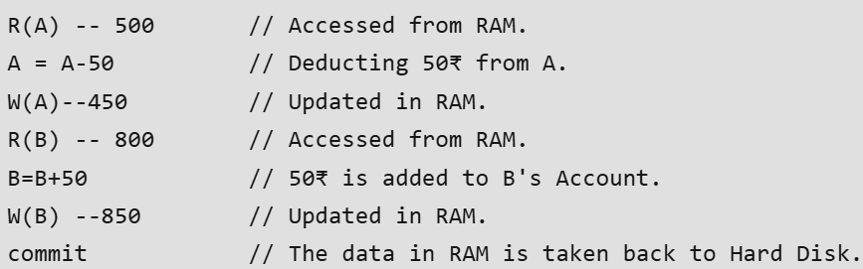
Transaction Management
Example: Transfer of 50₹ from Account A to Account B. Initially A= 500₹, B= 800₹. This data is brought to RAM from Hard Disk.

Slide 10
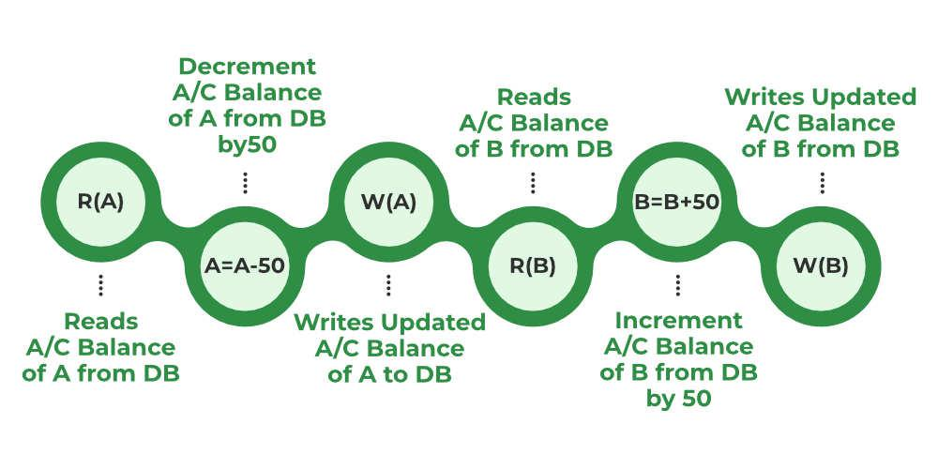
Transaction Management
Stages of Transaction
Note: The updated value of Account A = 450₹ and Account B = 850₹.
All instructions before committing come under a partially committed state and are stored in RAM. When the commit is read the data is fully accepted and is stored on a Hard Disk.

Slide 11
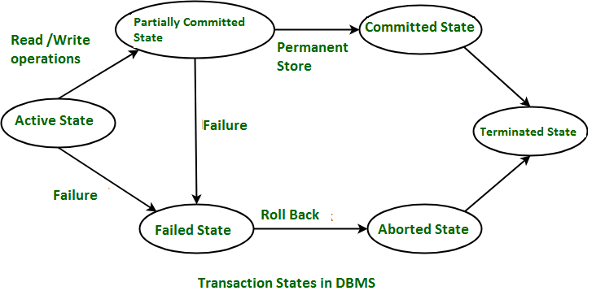
Transaction Management
Transaction States
Transactions can be implemented using SQL queries and Servers. In the diagram, you can see how transaction states work.

Slide 12
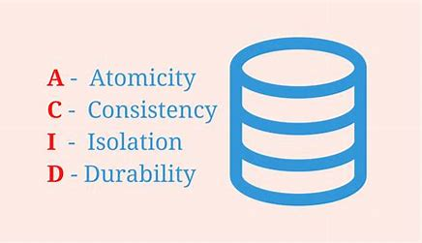
Transaction Management
Desirable Properties of Transaction (ACID Properties)
Transaction management in a Database Management System (DBMS) ensures that database transactions are executed reliably and follow ACID properties: Atomicity, Consistency, Isolation, and Durability. These principles help maintain data integrity, even during failures or concurrent user interactions, ensuring that all transactions are either fully completed or rolled back if errors occur.

Slide 13
Atomicity
States that all operations of the transaction take place at once if not, the transactions are aborted.
There is no midway, i.e., the transaction cannot occur partially. Each transaction is treated as one unit and either run to completion or is not executed at all.
Atomicity involves the following two operations:
Abort: If a transaction stops or fails, none of the changes it made will be saved or visible.
Commit: If a transaction completes successfully, all the changes it made will be saved and visible.
Atomicity

Slide 14
Consistency
The rules (integrity constraint) that keep the database accurate and consistent are followed before and after a transaction.
When a transaction is completed, it leaves the database either as it was before or in a new stable state.
This property means every transaction works with a reliable and consistent version of the database.
The transaction is used to transform the database from one consistent state to another consistent state. A transaction changes the database from one consistent state to another consistent state.
Consistency

Slide 15
Isolation
It shows that the data which is used at the time of execution of a transaction cannot be used by the second transaction until the first one is completed.
In isolation, if the transaction T1 is being executed and using the data item X, then that data item can’t be accessed by any other transaction T2 until the transaction T1ends.
The concurrency control subsystem of the DBMS enforced the isolation property
Isolation

Slide 16
Durability
The durability property is used to indicate the performance of the database’s consistent state. It states that the transaction made the permanent changes.
They cannot be lost by the erroneous operation of a faulty transaction or by the system failure. When a transaction is completed, then the database reaches a state known as the consistent state. That consistent state cannot be lost, even in the event of a system’s failure.
The recovery subsystem of the DBMS has the responsibility of Durability property.
Durability

Slide 17

Failure Classification
To find that where the problem has occurred, we generalize a failure into the following categories:
Transaction failure
System crash
Disk failure

Slide 18
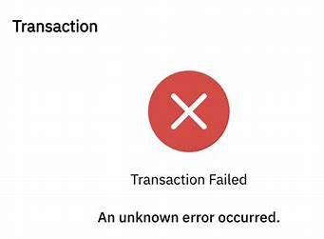
1.Transaction Failure
The transaction failure occurs when it fails to execute or when it reaches a point from where it can’t go any further. If a few transactions or process is hurt, then this is called as transaction failure.
Reasons for a transaction failure could be –
Logical errors: If a transaction cannot complete due to some code error or an internal error condition, then the logical error occurs.
Syntax error: It occurs where the DBMS itself terminates an active transaction because the database system is not able to execute it. For example, The system aborts an active transaction, in case of deadlock or resource unavailability.

Slide 19
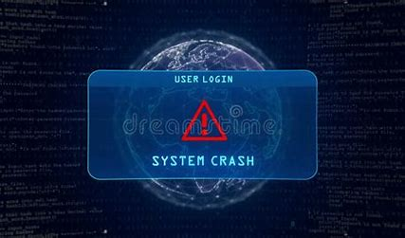
2. System Crash
System failure can occur due to power failure or other hardware or software failure. Example: Operating system error.
Fail-stop assumption: In the system crash, non-volatile storage is assumed not to be corrupted.

Slide 20

3. Disk Failure
It occurs where hard-disk drives or storage drives used to fail frequently. It was a common problem in the early days of technology evolution.
Disk failure occurs due to the formation of bad sectors, disk head crash, and unreachability to the disk or any other failure, which destroy all or part of disk storage.

Slide 21
Serializability
Serializability
It is an important aspect of Transactions. In simple meaning, you can say that serializability is a way to check whether two transactions working on a database are maintaining database consistency or not.
It is of two types:
Conflict Serializability
View Serializability

Slide 22
Conflict Serializable
Concurrency serializability, also known as conflict serializability, is a type of concurrency control that guarantees that the outcome of concurrent transactions is the same as if the transactions were executed consecutively.
Conflict serializable schedules: A schedule is called conflict serializable if it can be transformed into a serial schedule by swapping non-conflicting operations.
Non-conflicting operations: When two operations operate on separate data items or the same data item but at least one of them is a read operation, they are said to be non-conflicting.

Slide 23
Conflicting Operations
Two operations are said to be conflicting if all conditions are satisfied:
They belong to different transactions
They operate on the same data item
At Least one of them is a write operation
Example:
Conflicting operations pair (R1(A), W2(A)) because they belong to two different transactions on the same data item A and one of them is a write operation.
Similarly, (W1(A), W2(A)) and (W1(A), R2(A)) pairs are also conflicting.
On the other hand, the (R1(A), W2(B)) pair is non-conflicting because they operate on different data items.
Similarly, ((W1(A), W2(B)) pair is non-conflicting.

Slide 24
Consider the following schedule:
If Oi and Oj are two operations in a transaction and Oi< Oj (Oi is executed before Oj), same order will follow in the schedule as well. Using this property, we can get two transactions of schedule S1:
T1: R1(A), W1(A), R1(B), W1(B)
T2: R2(A), W2(A), R2(B), W2(B)
Possible Serial Schedules are: T1->T2 or T2->T1

Slide 25
Possible Serial Schedules are: T1->T2 or T2->T1
Swapping non-conflicting operations R2(A) and R1(B) in S1, the schedule becomes,
S11: R1(A), W1(A), R1(B), W2(A), R2(A), W1(B), R2(B), W2(B)
-> Similarly, swapping non-conflicting operations W2(A) and W1(B) in S11, the schedule becomes,
S12: R1(A), W1(A), R1(B), W1(B), R2(A), W2(A), R2(B), W2(B)
S12 is a serial schedule in which all operations of T1 are performed before starting any operation of T2. Since S has been transformed into a serial schedule S12 by swapping non-conflicting operations of S1, S1 is conflict serializable.

Slide 26
Conflict Equivalent
Two schedules are said to be conflict equivalent when one can be transformed to another by swapping non-conflicting operations. In the example discussed above, S11 is conflict equivalent to S1 (S1 can be converted to S11 by swapping non-conflicting operations). Similarly, S11 is conflict equivalent to S12, and so on.
Note 1: Although S2 is not conflict serializable, still it is conflict equivalent to S21 and S22 because S2 can be converted to S21 and S22 by swapping non-conflicting operations.
Note 2: The schedule which is conflict serializable is always conflict equivalent to one of the serial schedule. S1 schedule discussed above (which is conflict serializable) is equivalent to the serial schedule (T1->T2).

Slide 27
Advantages of Conflict Serializability
Consistency: Conflict serializability guarantees that the transactions’ outcomes correspond to the sequence in which they were carried out.
Correctness: Regardless of the order in which transactions were submitted, conflict serializability guarantees that transactions are executed correctly.
Decreased Overhead: By doing away with pointless locking and other conflict resolution techniques, conflict serializability lowers overhead.
Disadvantages of Conflict Serializability
Complexity: Conflict serializability can be complex to implement, especially in large and complex databases.
Reduced Performance: Conflict serializability can reduce performance by introducing delays and overhead due to locking and other conflict resolution mechanisms.
Limited Concurrency: Conflict serializability can limit the degree of concurrency in the system because it may delay some transactions to avoid conflicts.

Slide 28
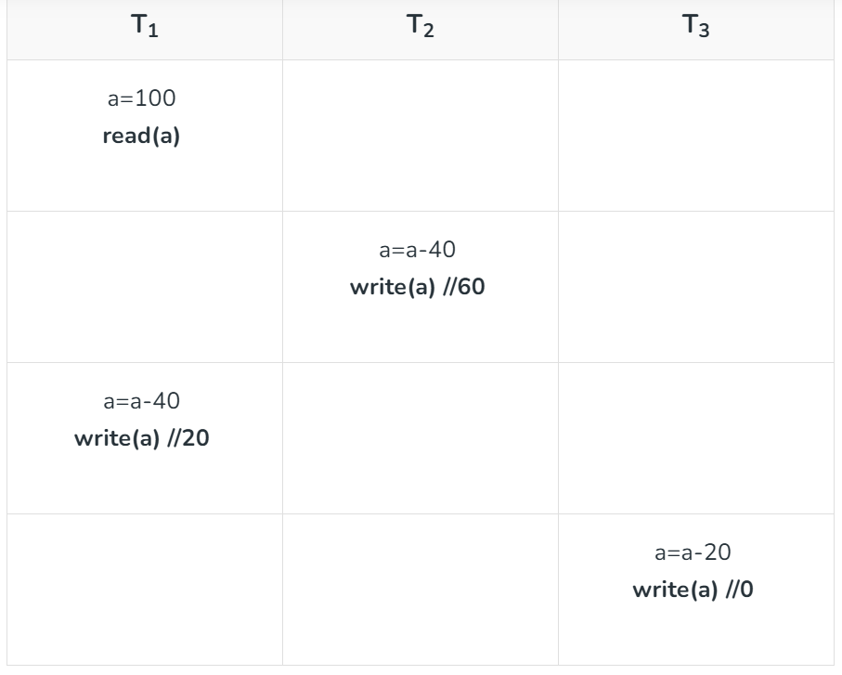
View Serializability
The View serializability is a concept that is used to compute whether schedules are View-Serializable or not. A schedule is said to be View-Serializable if it is viewing equivalent to a Serial Schedule (where no interleaving of transactions is possible).
Example: Understanding View-Serializability first with a Schedule S1 :

Slide 29
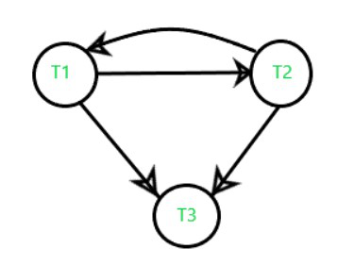
So, its Conflict Precedence Graph is as follows –
The above graph contains cycle/loop which means it is not conflict-serializable but it does not mean that it cannot be consistent and equivalent to the serial schedule it may or may not be.

Slide 30
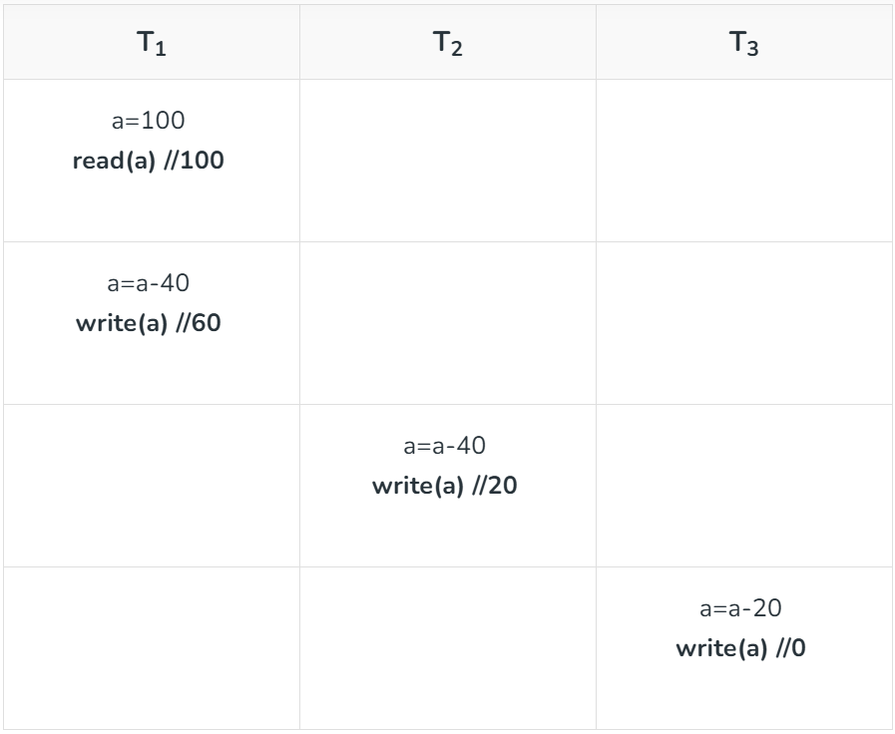
LookSchedule S’1 :
In the above example if we do swapping among some transaction’s operation so our table will look like this –

Slide 31
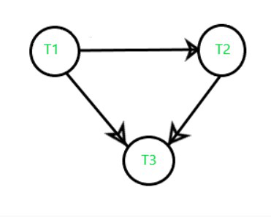
Its Precedence Graph is as follows –
Now, we see that the precedence graph of the second table does not contain any cycle/loop, which means it is conflict serializable (equivalent to serial schedule, consistent) and the final result is coming the same as the first table.
Note: In the above example we understood that if a schedule is Conflict-serializable so we can easily predict that It would be –
Equivalent to a serial schedule,
Consistent,
And also, a View-Serializable.

Slide 32
Schedule
Schedule, as the name suggests is a process of lining the transactions and executing them one by one. When there are multiple transactions that are running in a concurrent manner and the order of operation is needed to be set so that the operations do not overlap each other, Scheduling is brought into play and the transactions are timed accordingly.
It is of two types:
Serial Schedule
Non-Serial Schedule

Slide 33
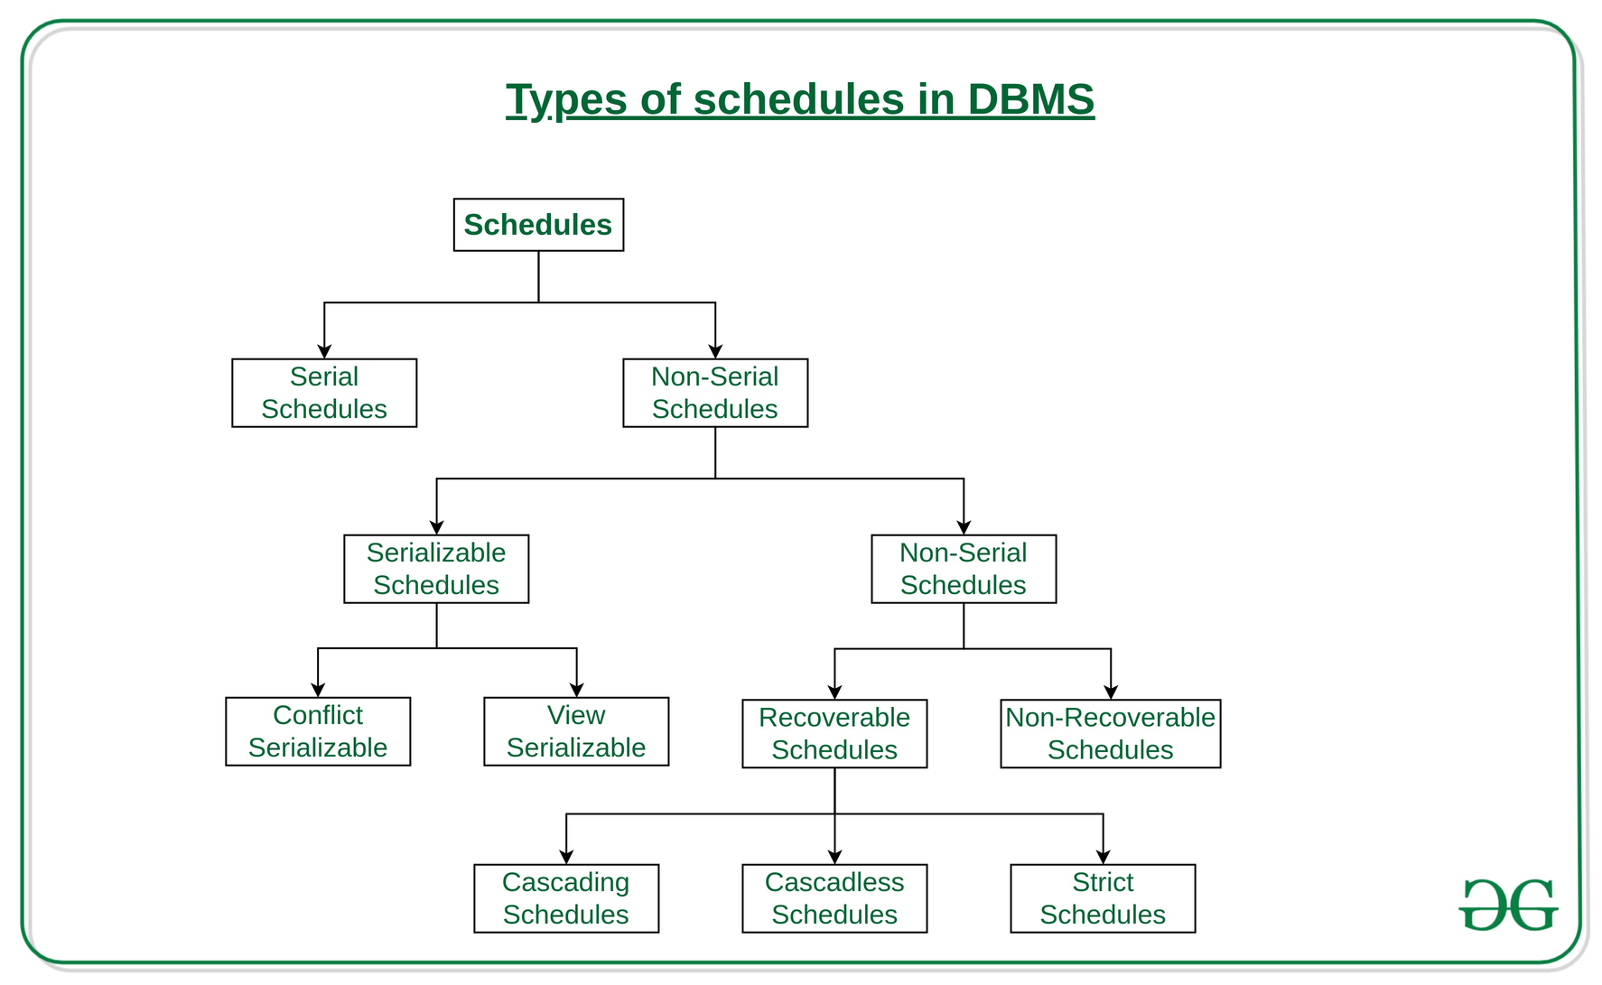
Types of Schedules in DBMS
Schedules in DBMS ensure that transactions are executed in a serializable order. Understanding the types of schedules is crucial for ensuring database consistency.

Slide 34
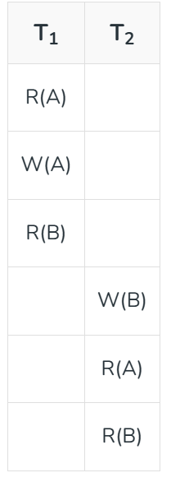
Serial Schedules:
Schedules in which the transactions are executed non-interleaved, i.e., a serial schedule is one in which no transaction starts until a running transaction has ended are called serial schedules. Example: Consider the following schedule involving two transactions T 1 and T 2 .
where R(A) denotes that a read operation is performed on some data item ‘A’ This is a serial schedule since the transactions perform serially in the order T 1 —> T 2

Slide 35
Non-Serial Schedule
This is a type of Scheduling where the operations of multiple transactions are interleaved. This might lead to a rise in the concurrency problem. The transactions are executed in a non-serial manner, keeping the end result correct and same as the serial schedule. Unlike the serial schedule where one transaction must wait for another to complete all its operation, in the non-serial schedule, the other transaction proceeds without waiting for the previous transaction to complete. This sort of schedule does not provide any benefit of the concurrent transaction. It can be of two types namely, Serializable and Non-Serializable Schedule. The Non-Serial Schedule can be divided further into Serializable and Non-Serializable.

Slide 36
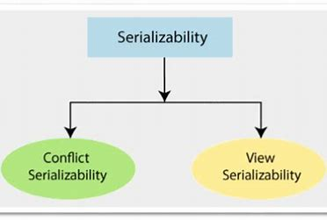
Serializable
This is used to maintain the consistency of the database. It is mainly used in the Non-Serial scheduling to verify whether the scheduling will lead to any inconsistency or not. On the other hand, a serial schedule does not need the serializability because it follows a transaction only when the previous transaction is complete. The non-serial schedule is said to be in a serializable schedule only when it is equivalent to the serial schedules, for an n number of transactions. Since concurrency is allowed in this case thus, multiple transactions can execute concurrently. A serializable schedule helps in improving both resource utilization and CPU throughput. These are of two types:
Conflict Serializable
View Serializable

Slide 37
Conflict Serializable
Concurrency serializability, also known as conflict serializability, is a type of concurrency control that guarantees that the outcome of concurrent transactions is the same as if the transactions were executed consecutively.
Conflict serializable schedules: A schedule is called conflict serializable if it can be transformed into a serial schedule by swapping non-conflicting operations.
Non-conflicting operations: When two operations operate on separate data items or the same data item but at least one of them is a read operation, they are said to be non-conflicting.

Slide 38
Conflicting Operations
Two operations are said to be conflicting if all conditions are satisfied:
They belong to different transactions
They operate on the same data item
At Least one of them is a write operation
Example:
Conflicting operations pair (R1(A), W2(A)) because they belong to two different transactions on the same data item A and one of them is a write operation.
Similarly, (W1(A), W2(A)) and (W1(A), R2(A)) pairs are also conflicting.
On the other hand, the (R1(A), W2(B)) pair is non-conflicting because they operate on different data items.
Similarly, ((W1(A), W2(B)) pair is non-conflicting.

Slide 39
View Serializable Schedule
A View Serializable Schedule is a type of schedule in DBMS that ensures the final outcome of the schedule is the same as that of a serial schedule, even if the operations are interleaved.
It is broader than Conflict Serializable Schedules, meaning all conflict-serializable schedules are view-serializable, but not all view-serializable schedules are conflict-serializable.
Example of a View Serializable Schedule
The initial read condition is satisfied as T2T2T2 reads AAA after T1T1T1 writes it.
The final write condition is satisfied as T3T3T3 performs the final write on AAA.
The read-write dependency condition is satisfied as T2T2T2 reads the value of AAA written by T1T1T1.

Slide 40
Conditions for View Serializability A schedule is view-serializable if it satisfies the following three conditions:
Initial Read Condition:
If a transaction TiT_iTi​ reads a data item initially (i.e., no other transaction writes it before TiT_iTi​), then in the equivalent serial schedule, TiT_iTi​ must also be the first to read that data item.
Final Write Condition:
If a transaction TjT_jTj​ performs the final write on a data item in the schedule, it must also perform the final write in the equivalent serial schedule.
Read-Write Dependency Condition:
If a transaction TkT_kTk​ reads a data item XXX written by TmT_mTm​ in the schedule, then TkT_kTk​ must read XXX after TmT_mTm​ writes it in the equivalent serial schedule.

Slide 41
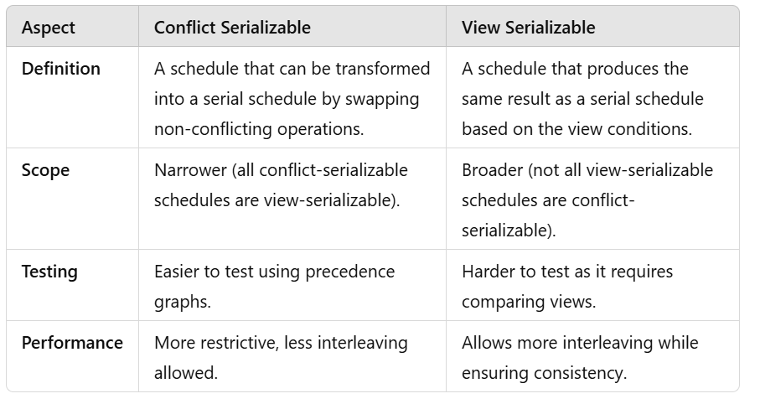
Difference Between View Serializability and Conflict Serializability

Slide 42
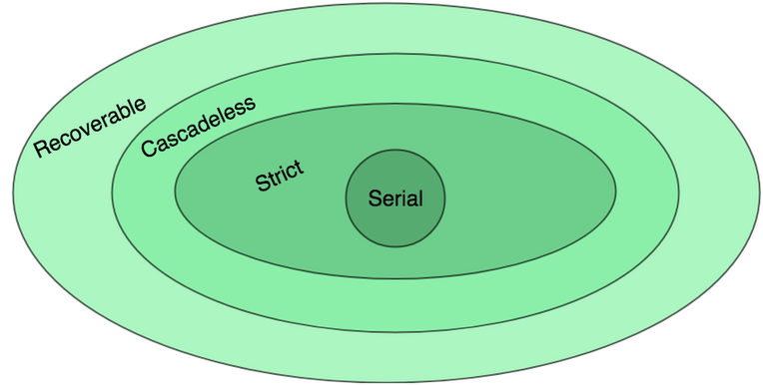
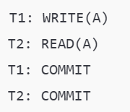
1. Recoverable Schedules
A recoverable schedule ensures that if a transaction TiT_iTi​ reads data modified by another transaction TjT_jTj​, TjT_jTj​ must commit before TiT_iTi​ commits. This ensures that the database can be recovered to a consistent state if a failure occurs.
Key Features:
Ensures no cascading aborts.
Maintains consistency during failures.
Example of a Recoverable Schedule:
T2 reads the value of AAA written by T1T1T1.
T1T1T1 commits before T2T2T2, making the schedule recoverable.
Importance:
Recoverable schedules prevent data inconsistency during rollbacks.

Slide 43
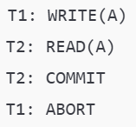
2. Non-Recoverable Schedules
A non-recoverable schedule occurs when a transaction TiT_iTi​ reads data written by TjT_jTj​, but TjT_jTj​ is not committed before TiT_iTi​ commits. If TjT_jTj​ later aborts, it becomes impossible to maintain consistency because TiT_iTi​ has already committed invalid data.
Example of a Non-Recoverable Schedule:
T2T2T2 reads the value of AAA written by T1T1T1.
T2T2T2 commits before T1T1T1, but T1T1T1 aborts, making the data read by T2T2T2 invalid.
This leads to inconsistency and makes recovery impossible.

Slide 44
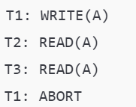
Cascading Abort Schedules
A cascading abort schedule occurs when the failure of one transaction causes multiple other transactions to roll back because they read uncommitted data.
Example:
T2 and T3T3T3 read uncommitted data written by T1T1T1.
When T1T1T1 aborts, both T2T2T2 and T3T3T3 must also abort, leading to a cascading rollback.

Slide 45
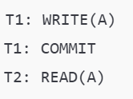
Cascadeless Schedules
A cascadeless schedule avoids cascading aborts by ensuring that a transaction TiT_iTi​ can only read data written by another transaction TjT_jTj​ if TjT_jTj​ has already committed.
Example:
T2 reads the value of AAA only after T1T1T1 has committed, ensuring no cascading aborts.
Benefits:
Simplifies recovery.
Reduces the number of transactions affected by rollbacks.

Slide 46
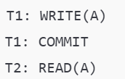
Strict Schedules
A strict schedule ensures that a transaction TiT_iTi​ can neither read nor write a data item modified by another transaction TjT_jTj​ until TjT_jTj​ has committed or aborted.
Example:
T2 cannot access AAA until T1T1T1 has completed, making recovery straightforward.
Benefits:
Guarantees recoverability.
Avoids cascading aborts.

Slide 47
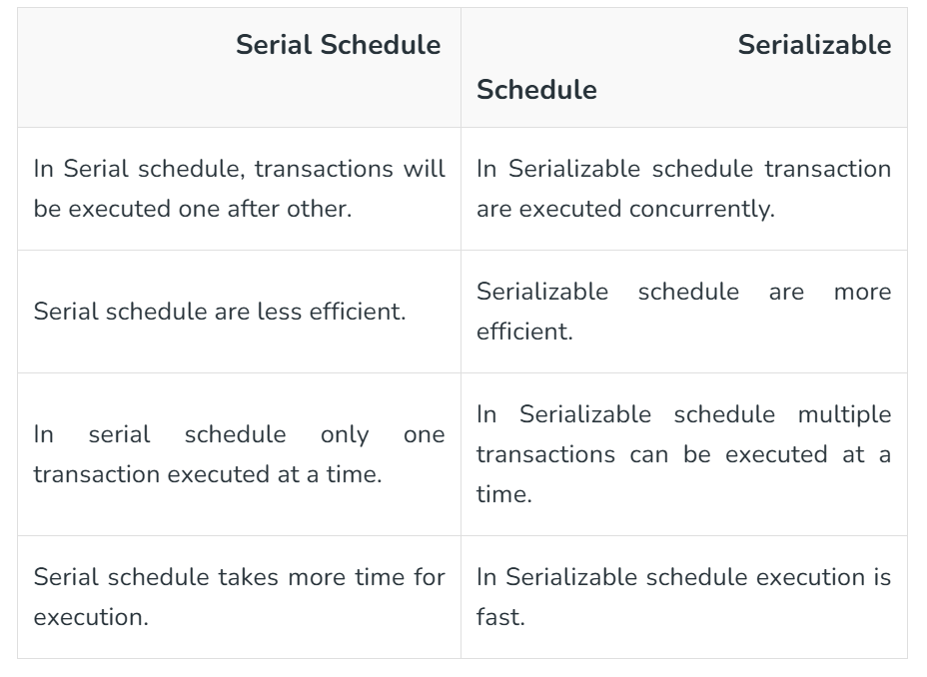
Difference between Serial Schedule and Serializable Schedule
Serial Schedule
Serializable Schedule

Slide 48
Concurrency Control
Concurrency control is a very important concept of DBMS which ensures the simultaneous execution or manipulation of data by several processes or user without resulting in data inconsistency. Concurrency Control deals with interleaved execution of more than one transaction.
Goals of Concurrency Control
Maintain Database Consistency: Ensure that the database remains in a consistent state even when multiple transactions execute concurrently.
Isolation: Provide each transaction the illusion of being executed alone.
Maximize Throughput: Allow maximum concurrency without compromising data integrity.
Avoid Anomalies: Prevent problems such as lost updates, dirty reads, uncommitted data, and non-repeatable reads.

Slide 49
Concurrency Control
Executing a single transaction at a time will increase the waiting time of the other transactions which may result in delay in the overall execution. Hence for increasing the overall throughput and efficiency of the system, several transactions are executed.
Concurrency control is a very important concept of DBMS which ensures the simultaneous execution or manipulation of data by several processes or user without resulting in data inconsistency.
Concurrency control provides a procedure that is able to control concurrent execution of the operations in the database.
The fundamental goal of database concurrency control is to ensure that concurrent execution of transactions does not result in a loss of database consistency. The concept of serializability can be used to achieve this goal, since all serializable schedules preserve consistency of the database. However, not all schedules that preserve consistency of the database are serializable.

Slide 50
Dirty Read Problem(Write-Read conflict)
Dirty read problem occurs when one transaction updates an item but due to some unconditional events that transaction fails but before the transaction performs rollback, some other transaction reads the updated value. Thus creates an inconsistency in the database. Dirty read problem comes under the scenario of Write-Read conflict between the transactions in the database
The lost update problem can be illustrated with the below scenario between two transactions T1 and T2.
Transaction T1 modifies a database record without committing the changes.
T2 reads the uncommitted data changed by T1
T1 performs rollback
T2 has already read the uncommitted data of T1 which is no longer valid, thus creating inconsistency in the database.

Slide 51
Lost Update Problem
Lost update problem occurs when two or more transactions modify the same data, resulting in the update being overwritten or lost by another transaction. The lost update problem can be illustrated with the below scenario between two transactions T1 and T2.
T1 reads the value of an item from the database.
T2 starts and reads the same database item.
T1 updates the value of that data and performs a commit.
T2 updates the same data item based on its initial read and performs commit.
This results in the modification of T1 gets lost by the T2’s write which causes a lost update problem in the database.

Slide 52
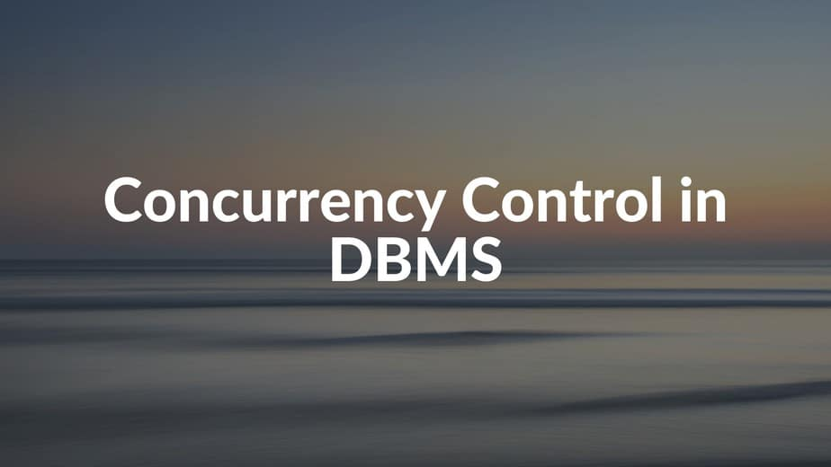
Concurrency Control Protocols
Concurrency control protocols are the set of rules which are maintained in order to solve the concurrency control problems in the database. It ensures that the concurrent transactions can execute properly while maintaining the database consistency. The concurrent execution of a transaction is provided with atomicity, consistency, isolation, durability, and serializability via the concurrency control protocols.
Locked based concurrency control protocol
Timestamp based concurrency control protocol

Slide 53
Locked based Protocol
In locked based protocol, each transaction needs to acquire locks before they start accessing or modifying the data items. There are two types of locks used in databases.
Shared Lock : Shared lock is also known as read lock which allows multiple transactions to read the data simultaneously. The transaction which is holding a shared lock can only read the data item but it can not modify the data item.
Exclusive Lock : Exclusive lock is also known as the write lock. Exclusive lock allows a transaction to update a data item. Only one transaction can hold the exclusive lock on a data item at a time. While a transaction is holding an exclusive lock on a data item, no other transaction is allowed to acquire a shared/exclusive lock on the same data item.

Slide 54
Phase Locking Protocol
There are two kind of Two-Phase protocol mostly used in database:
Two Phase Locking Protocol : It is a widely used technique which ensures strict ordering of lock acquisition and release. Two phase locking protocol works in two phases.
Growing Phase : In this phase, the transaction starts acquiring locks before performing any modification on the data items. Once a transaction acquires a lock, that lock can not be released until the transaction reaches the end of the execution.
Shrinking Phase : In this phase, the transaction releases all the acquired locks once it performs all the modifications on the data item. Once the transaction starts releasing the locks, it can not acquire any locks further.
Strict Two-Phase Locking Protocol : It is almost similar to the two phase locking protocol the only difference is that in two phase locking the transaction can release its locks before it commits, but in case of strict two phase locking the transactions are only allowed to release the locks only when they performs commits.

Slide 55
Timestamp Based Concurrency Control
The main idea for this protocol is to order the transactions based on their Timestamps. A schedule in which the transactions participate is then serializable and the only equivalent serial schedule permitted has the transactions in the order of their Timestamp Values. Stating simply, the schedule is equivalent to the particular Serial Order corresponding to the order of the Transaction timestamps. An algorithm must ensure that, for each item accessed by Conflicting Operations in the schedule, the order in which the item is accessed does not violate the ordering. To ensure this, use two Timestamp Values relating to each database item X.
W­_TS(X) is the largest timestamp of any transaction that executed write(X) successfully.
R_TS(X) is the largest timestamp of any transaction that executed read(X) successfully.

Slide 56
Advantages of Concurrency Control
In general, concurrency means, that more than one transaction can work on a system. The advantages of a concurrent system are:
Waiting Time: It means if a process is in a ready state but still the process does not get the system to get execute is called waiting time. So, concurrency leads to less waiting time.
Response Time: The time wasted in getting the response from the cpu for the first time, is called response time. So, concurrency leads to less Response Time.
Resource Utilization: The amount of Resource utilization in a particular system is called Resource Utilization. Multiple transactions can run parallel in a system. So, concurrency leads to more Resource Utilization.
Efficiency: The amount of output produced in comparison to given input is called efficiency. So, Concurrency leads to more Efficiency.

Slide 57
Disadvantages of Concurrency Control
Overhead: Implementing concurrency control requires additional overhead, such as acquiring and releasing locks on database objects. This overhead can lead to slower performance and increased resource consumption, particularly in systems with high levels of concurrency.
Deadlocks: Deadlocks can occur when two or more transactions are waiting for each other to release resources, causing a circular dependency that can prevent any of the transactions from completing. Deadlocks can be difficult to detect and resolve, and can result in reduced throughput and increased latency.
Reduced concurrency: Concurrency control can limit the number of users or applications that can access the database simultaneously. This can lead to reduced concurrency and slower performance in systems with high levels of concurrency.
Complexity: Implementing concurrency control can be complex, particularly in distributed systems or in systems with complex transactional logic. This complexity can lead to increased development and maintenance costs.

Slide 58
THANK YOU

